Slide 1
New Solutions
Innovation Fund Denmark strengthens growth and employment throughout Denmark by means of knowledge-based research, innovation and entrepreneurship.

Slide 2
Innovation Fund Denmark’s Locations
Head Quarters in Aarhus (as of 1 June 2019)
Offices in Odense, Aalborg and Copenhagen
Strengthens the regional presence throughout Denmark – and the coupling to the new business support system

Slide 3
Innovation Fund Denmark in Numbers
DKK 1.5 billion
in 2019
2,300
active projects
DKK 8.5 billion
active portfolio
3,200/year
applications
470
international grants
3
gateways

Slide 4
Innobooster

Slide 5
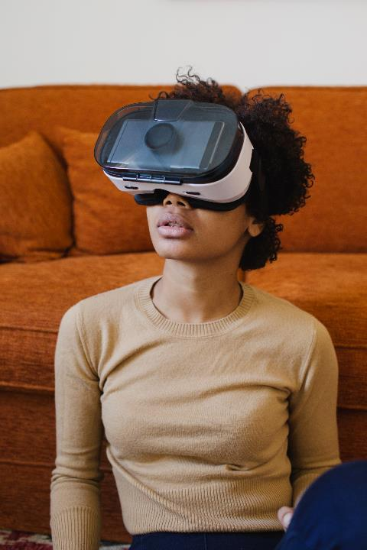
Innovative Ideas with Goal and Direction
Invests in knowledge-based development projects in SMEs, hereunder start-ups.
Typically, focus on the development of new products and services or significantly improved processes in the company.
Annual budget: Approx. DKK 300 million.

Slide 6
Innobooster co-finances up to 33 % of the expenses for a specific, knowledge-based development project.
May invest between DKK 50,000 and 5 million in a project.
The company which applies will select collaboration partners, receive the investment and provide own financial contribution.
Duration from three months to two years.
Fast processing of application – (almost always) a response to applications within a month.

Slide 7
The Four Evaluation Criteria
Novelty value: Is it new within the industry? Is it difficult? Does it require development?
Business potential: Will the project produce growth in the company?
Implementation: Is the project credible and well planned? Does the team have the skills?
Financial efficiency: Is the investment amount reasonable compared to risk and potential?

Slide 8
Examples

Slide 9
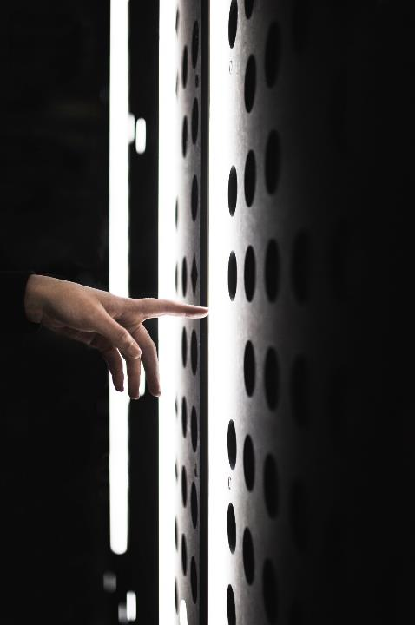
Most common mistakes
Not reading the guidelines
Applying for funding for an entire game (see next slide)
Lack of market validation
Because it is digital, it does not have to be development
Unclear activity plans (see following slide)

Slide 10
How to approach the InnoBooster as a games developer
The game
The project

Slide 11
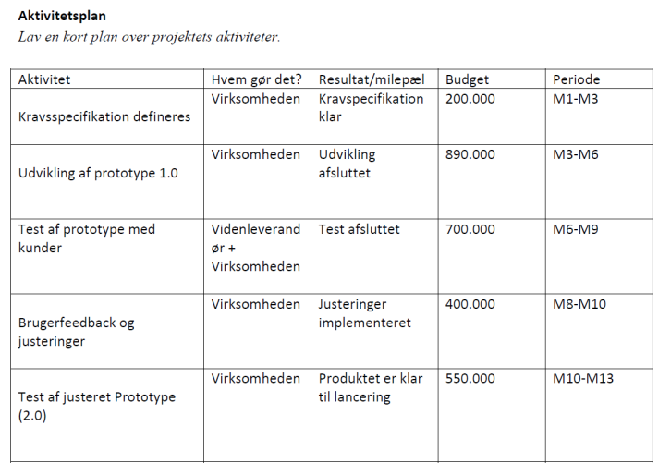
Activity plan

Slide 12
Questions?

Slide 13
Thank you for today!

